Slide 1

Image Restoration

Slide 2
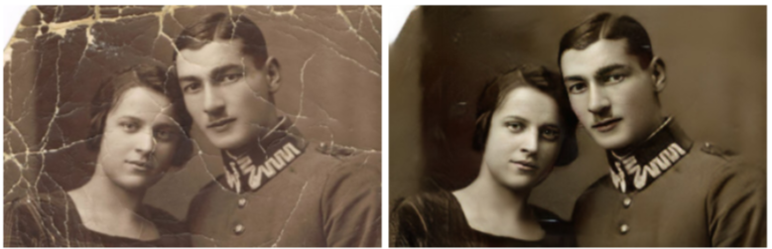
Problem Statement
Historical images and prints tend to have noisy resolutions in comparison to present day. Other images, online or in-print, might have distorted colors or deteriorated segments.
Images as such can be enhanced and restored back to its original format if not better through deep machine learning.

Slide 3
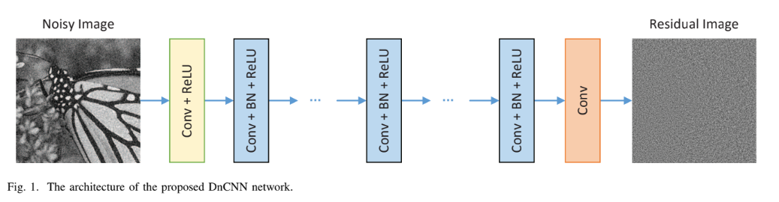
Original Model
Architecture

Slide 4
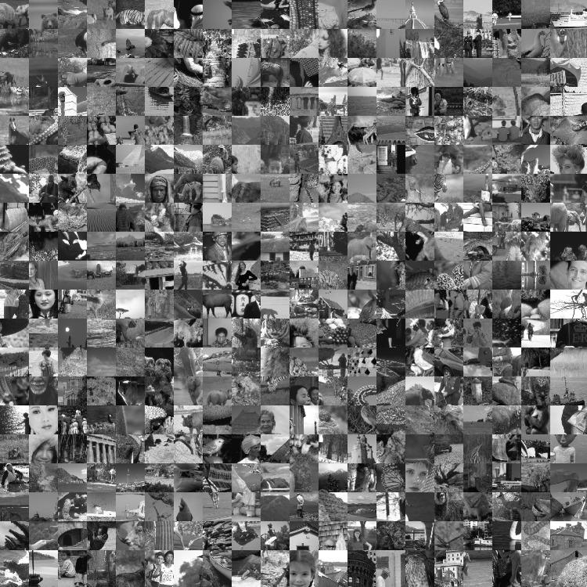
Original Model
Dataset:- Train 400

Slide 5
Final Model Architecture
+ Dropout
+ Dropout
+ Dropout

Slide 6
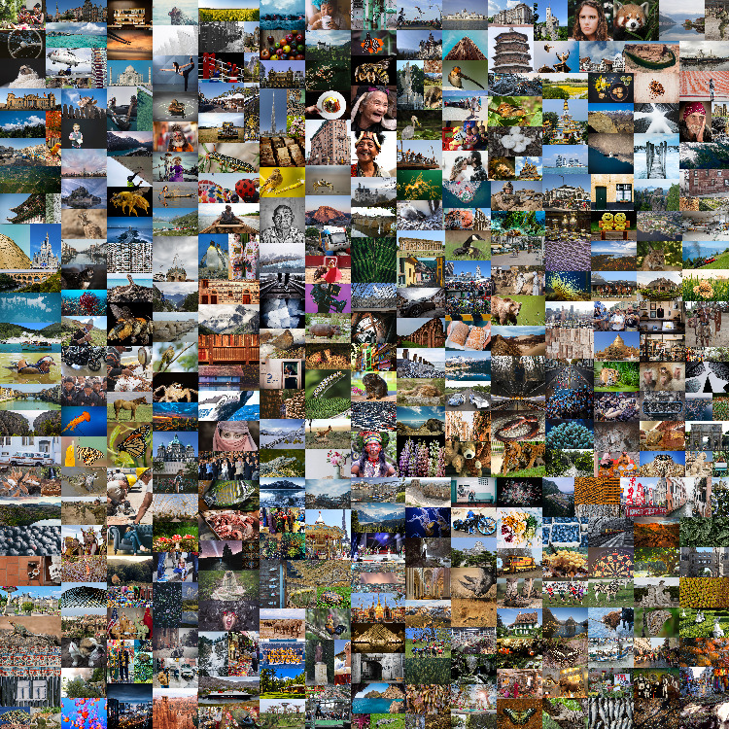
Current Dataset
Dataset:- DIV2K

Slide 7
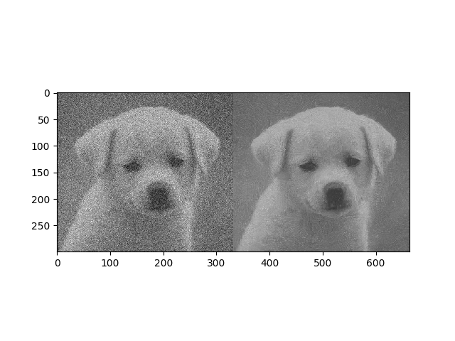
Results:- GreyScale

Slide 8
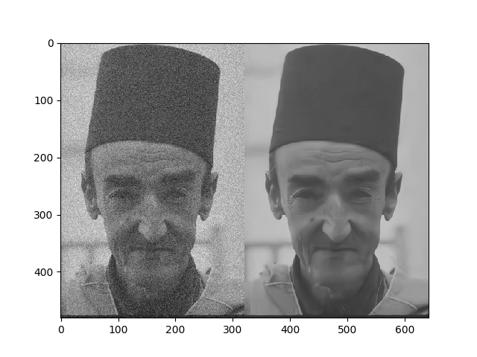
Results:- GreyScale

Slide 9
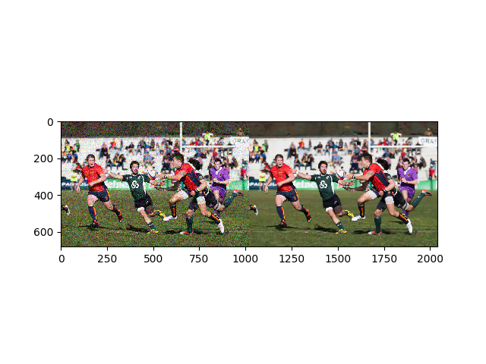
Results:- RGB

Slide 10
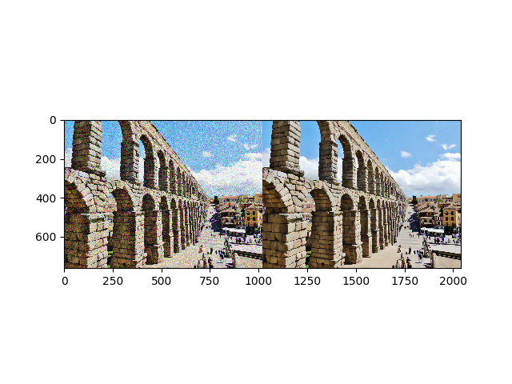
Results:- RGB

Slide 11
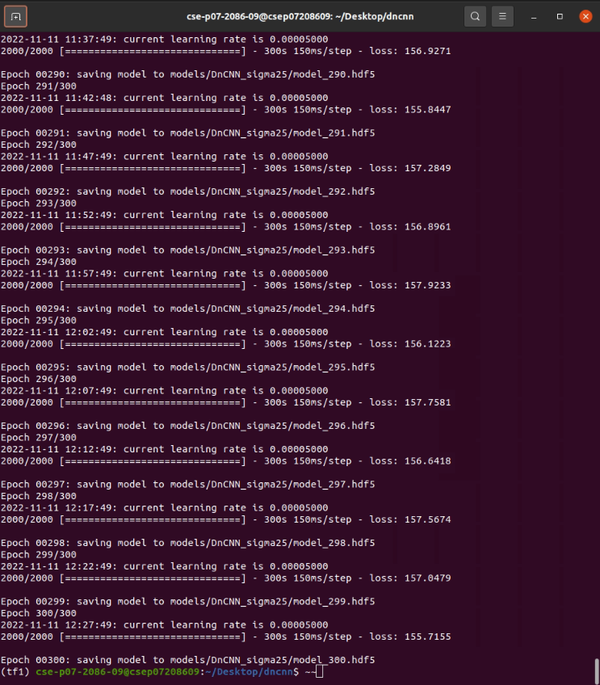
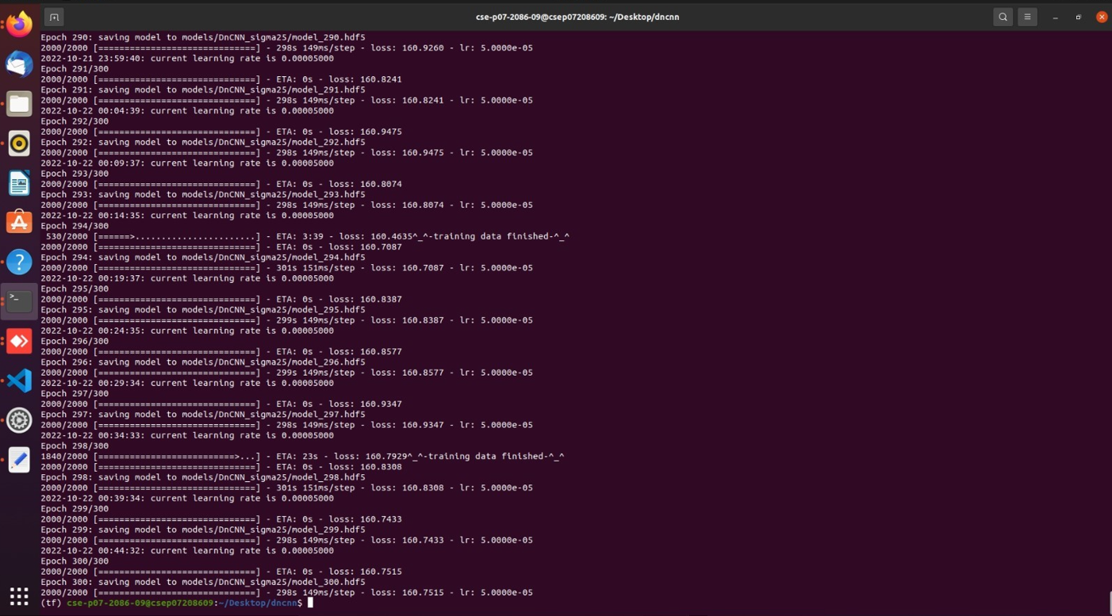
Loss - Current vs Original Models

Slide 12
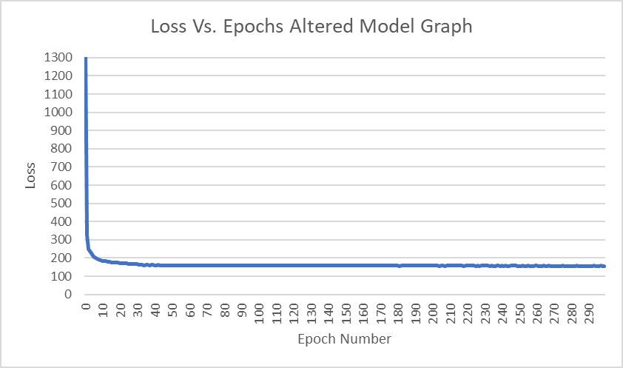
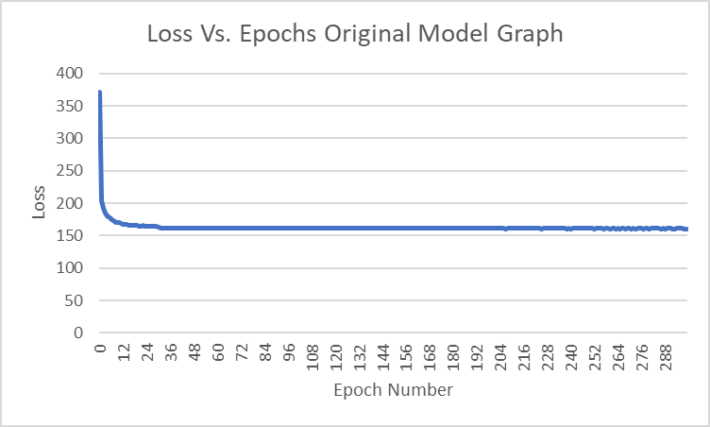
Plots and graphs

Slide 13
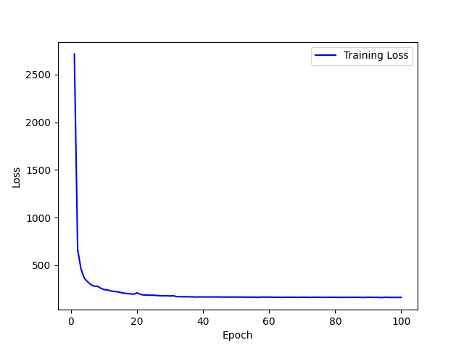
Plots and graphs:- Loss

Slide 14
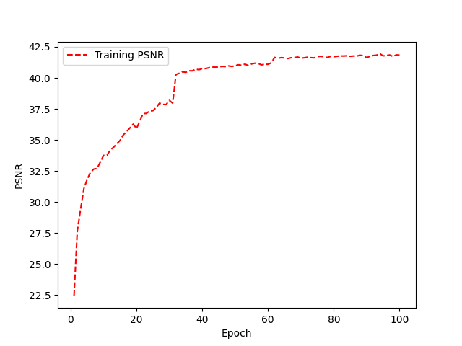
Plots and graphs:-PSNR

Slide 15
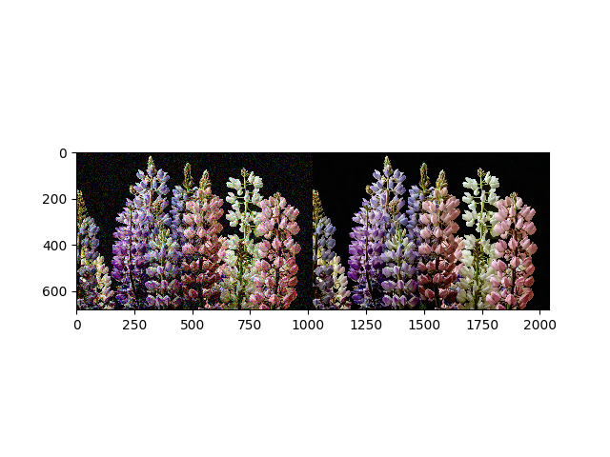
Conclusion
The model now is able to enhance noisy RGB images of different sizes into high resolution images with the help of using 2D CNN of 3 channels and padding any heterogeneous image sizes. The model is also measured using the PSNR metrics.

Slide 16
Future Work
Be able to enhance the accuracy.
Allow the model to accept videos and reduce its noise
Eliminate any noise from images
Enhance the resolution of medical scans

Slide 17
Team Member Contribution
Maya Hussein Nada Badawi
Displayed PSNR Metrics Display the output image
Plot PSNR Graph Plot Loss Graph
Both
Tested/Validated the model
Retrained the model to update metrics
GitHub: https://github.com/mayammakram/Deep_Learning_Image_Restoration

